Slide 1
MAY LAI – Power Profile
2016.10.29 @ SG

Slide 2
Notes:
No boss in the world would give you prosperity.
The opportunity is created by yourself,
Because only you can decide your own life.
The boss only gives you a position,
Not your future

Slide 3
Luck 1:
A fair, feasible and workable system
Luck 2:
Wealth generating movement -> the average person can make technology money + consumption money
Luck 3:
Passive income -> FREEDOM lifestyle

Slide 4
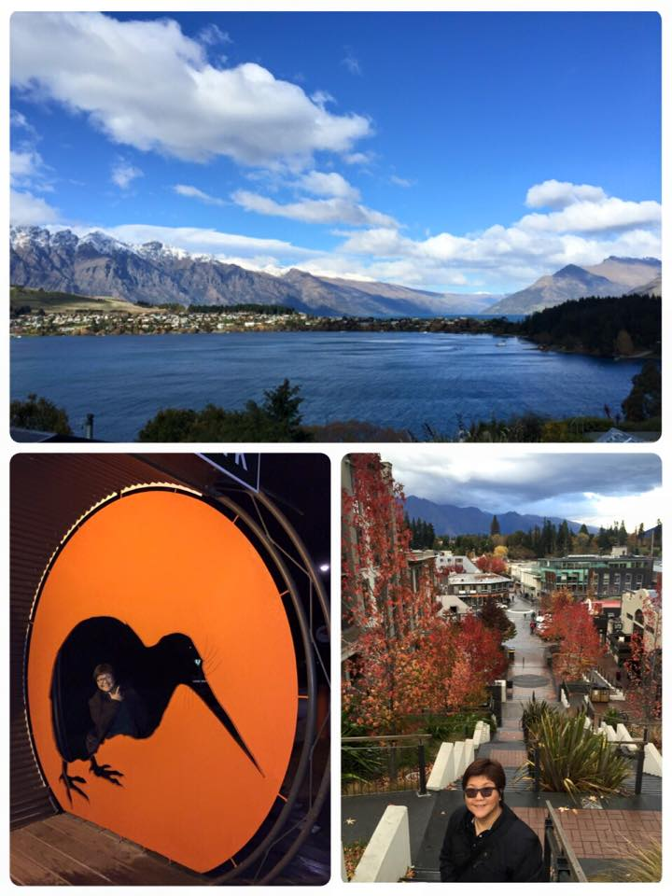

Slide 5
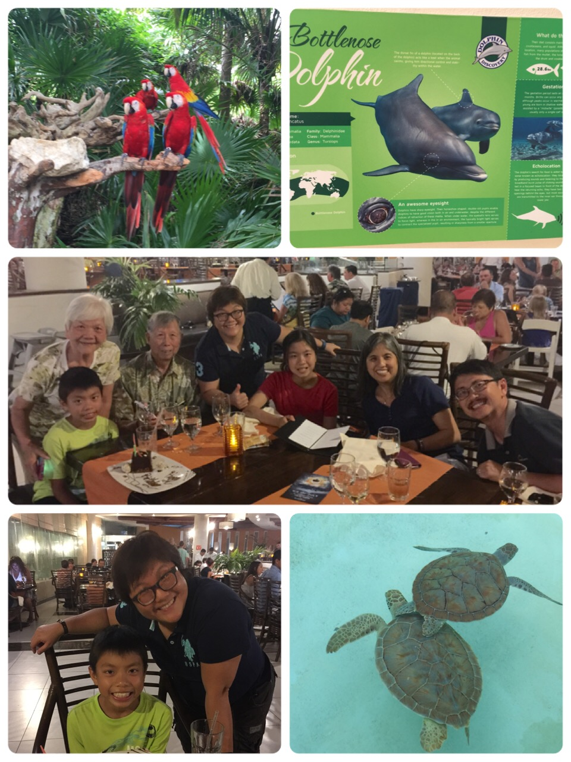
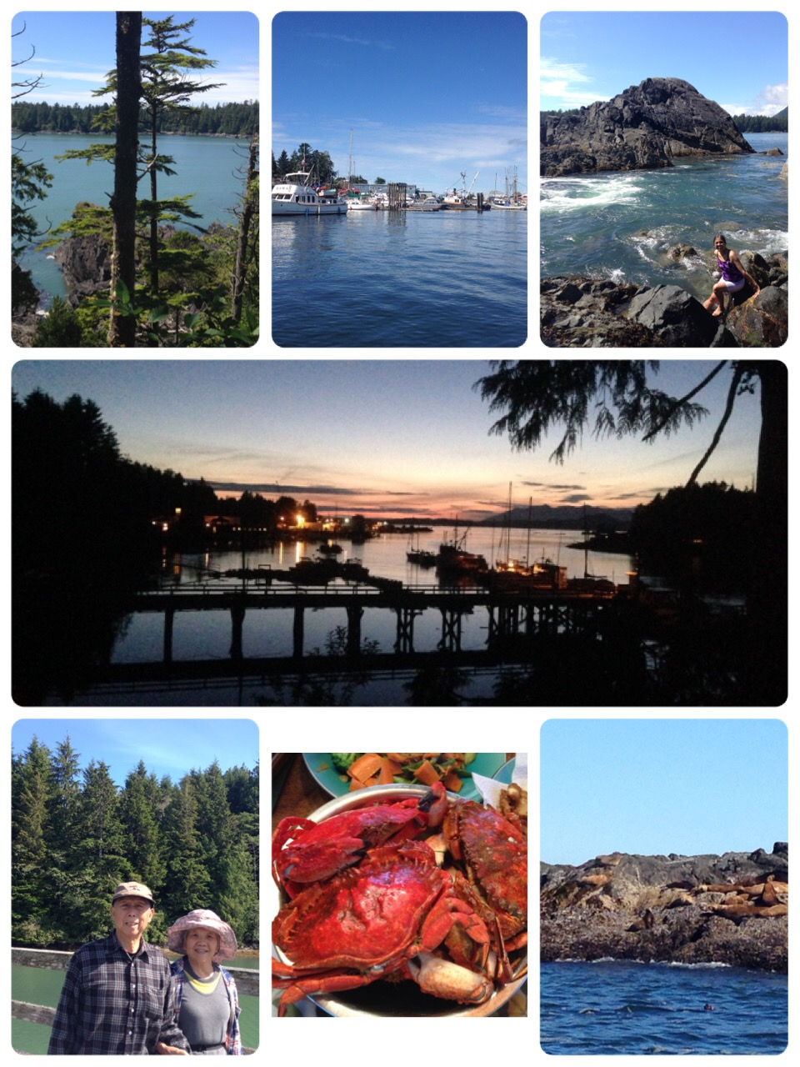
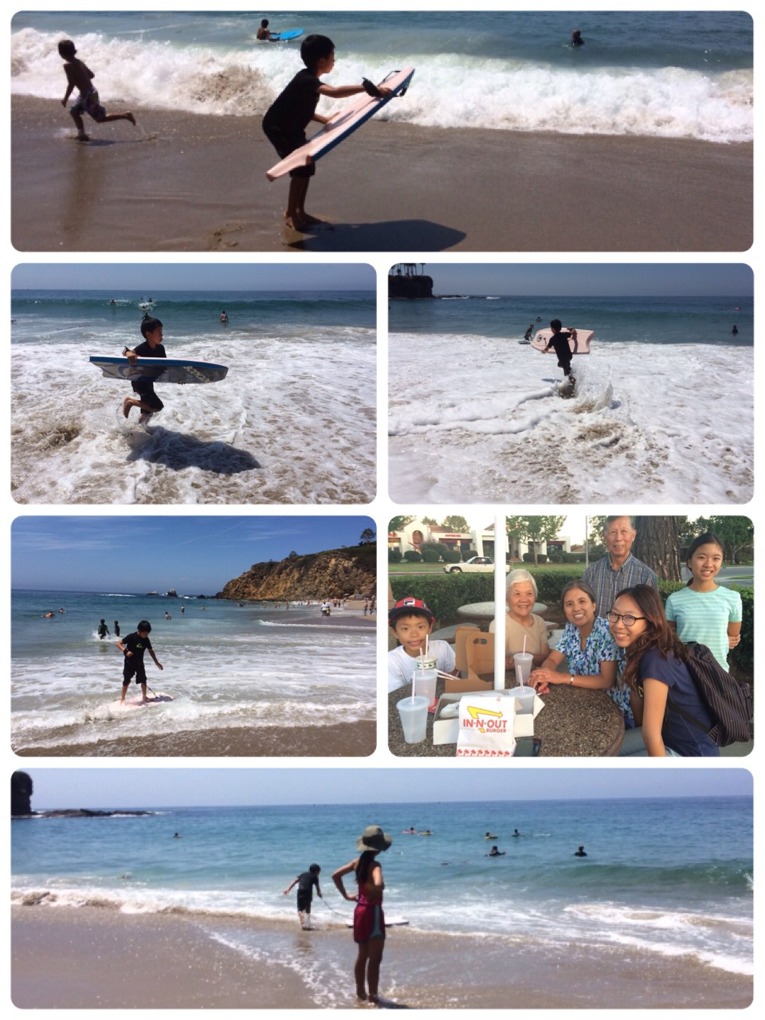

Slide 6
There’s no free lunch:
◆ 2002 - Shop.com USA
◆ 2005 –TW (31 times）
◆ 2007 – HK (46 times）
◆ 2014 – SG (15 times）
Investment - Earn S$18,750 per month passive income

Slide 7
Knowing your WHY –
MA and you both have
WHY HOW WHAT
Companies How
Your How
Combine your WHY and the
WHY of the company
Synergy!
Your What
Your Why

Slide 8
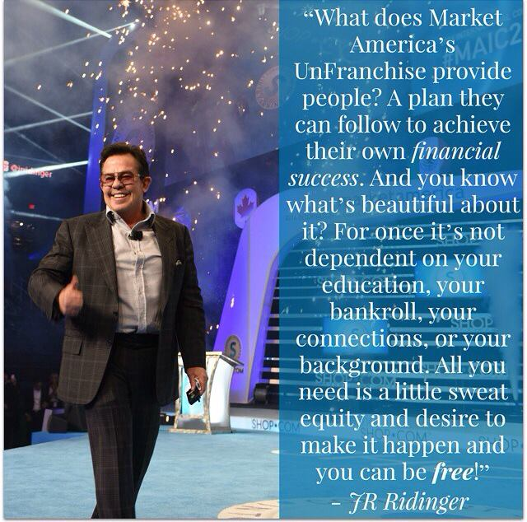
Convert Spending into Earning = Residual Income Change the world

Slide 9
Doing MA Business is the process of “building from nothing to something, from something to BIG, from Big to Strong and from Strong to Lasting ” - （Chen Min）

Slide 10
Self-cultivation, family Harmony, Ruling a country and Conquering the whole world -
Lead by Example:
Prepare yourself before you lead the team

Slide 11
GROW - from meeting to meeting!
DONE vs. Well DONE
(if something is worth doing it's worth doing well)

Slide 12
Simplify Things
Effective and Result-producing Activities
Using and selling products
Sharing business opportunities
Sharing shopping annuity
Buying and selling tickets
（sharing education）

Slide 13
Shopping Annuity is the accelerator to the MPCP!
Through helping people SAVE $$$, we can MAKE $$$.

Slide 14
Shopping annuity is the “What is It ? ” of the
business opportunity Transfer monthly spending of S$ 1250,
and earn residual income of S$ 12,500 per month
- Stable Organization/ Team Culture

Slide 15
You have to know JR’s vision: Attend the 2017 Annual Conference in Singapore! Attend the World Conference in the US dated Feb 9 to 11, 2017.
Companies How
Your How
Your What
Your Why

Slide 16
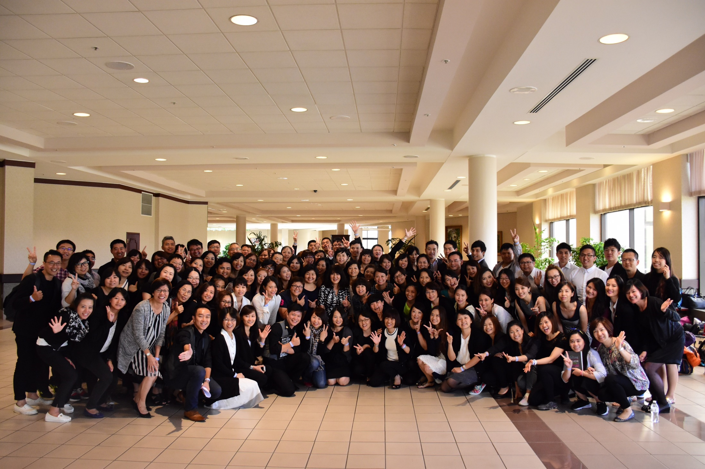
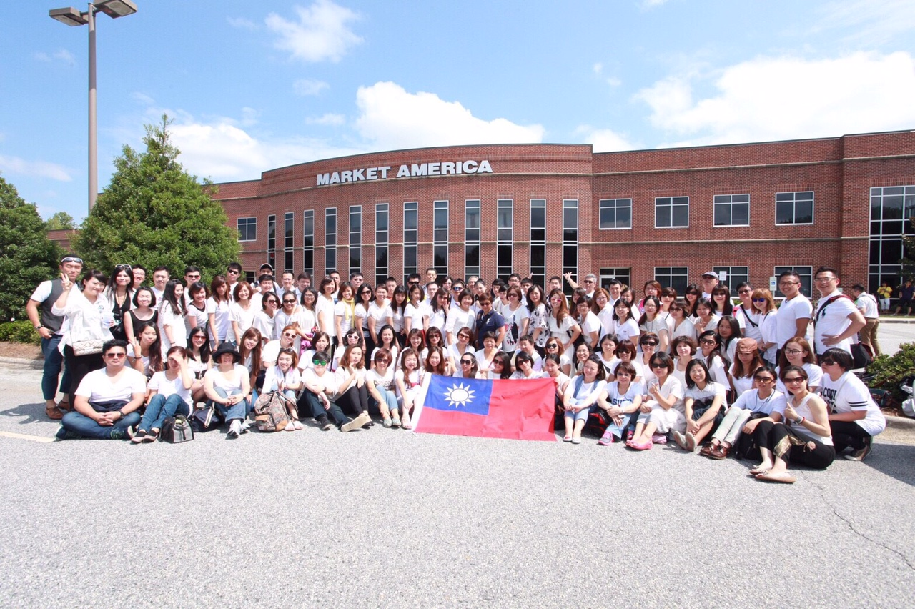
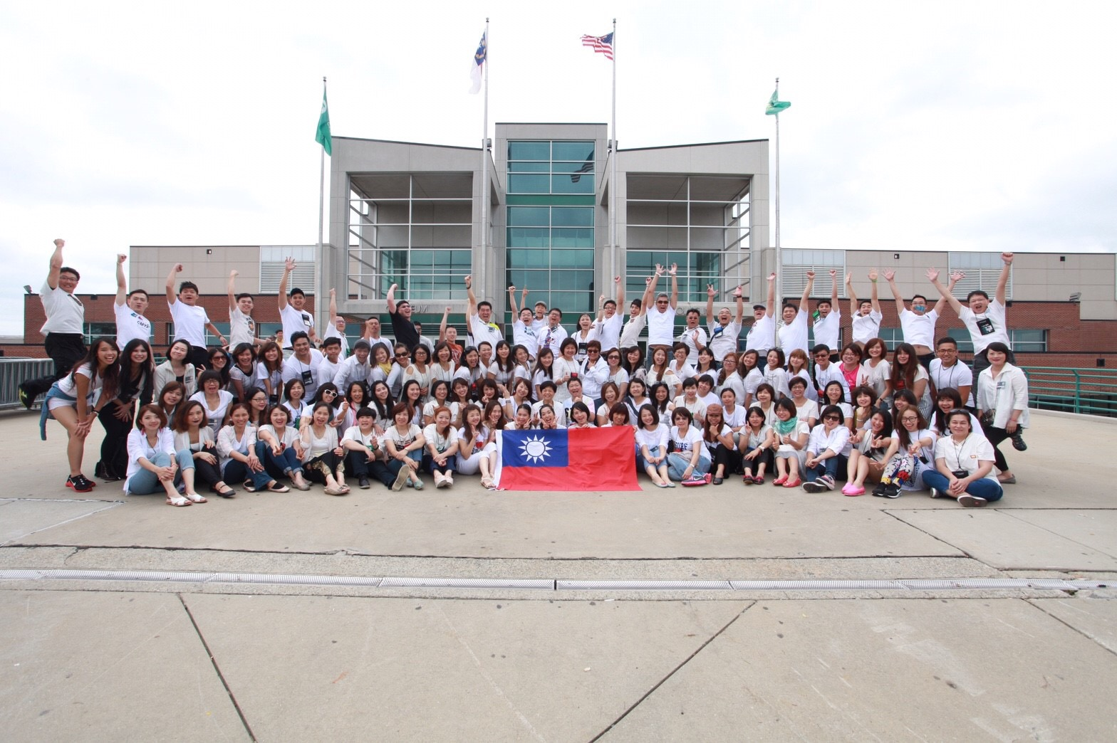
Attend the conferences in the US

Slide 17
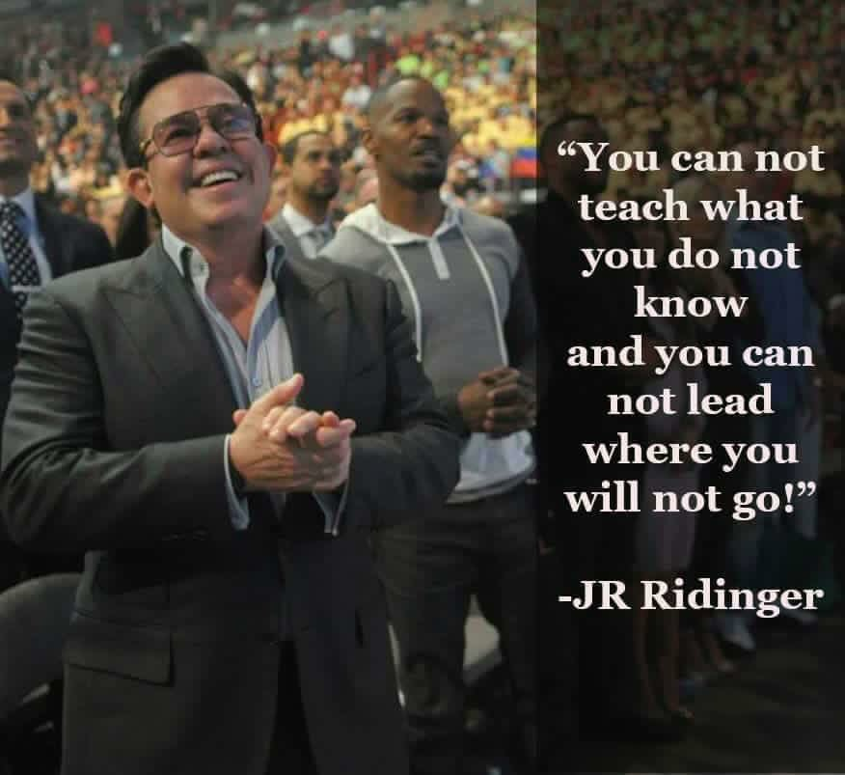
The Sky
The Limit!
Unlimited business opportunities

